Slide 1
Building a toolkit for pain Medical management
Dr. Antoni Chan
Consultant Rheumatologist and Associate Medical Director
Royal Berkshire NHS Foundation Trust
Reading, UK
June 2021

Slide 2
What is pain?
Building a tool kit for managing pain
What is pain?
Different types of pain – why it matters
Which medical therapies should I use and how?
When the drug work and when they don’t
My toolkit

Slide 3
What is pain?
International Association for the Study of Pain (IASP)*
“An unpleasant sensory and emotional experience associated with, or resembling that associated with, actual or potential tissue damage”
*https://www.iasp-pain.org/PublicationsNews/NewsDetail.aspx?ItemNumber=10475 (accessed June 2021)

Slide 4
What do I make of pain?
Understanding pain
Pain is personal
Unpleasant sensory and emotional experience
Actual or potential tissue damage
Pain is based on life experiences
Pain is described individually

Slide 5
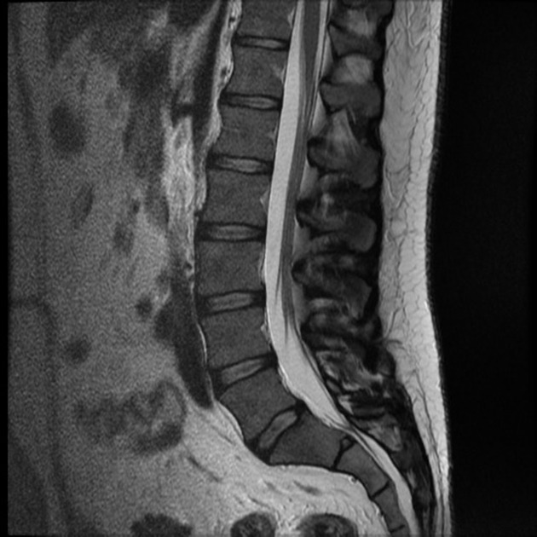
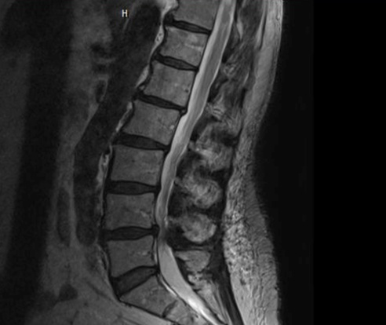
Who gets pain?
The absence of abnormal tissue injury does not mean there is no pain
Vs
Normal MRI scan of Lumbar spine
Lumbar Spinal stenosis on MRI scan

Slide 6
Different types of Pain
Not all pain is the same, one treatment doesn’t fit all
Nociceptive
Nociplastic
Neuropathic
Nociceptive pain
Acute tissue injury
Fracture
Acute arthritis
Acute back pain
Mixed Pain
Nociception + Nociplastic
Chronic back and neck pain
Autoimmune disease
Spinal stenosis
Neuropathic pain
Nerve damage
Stroke
Multiple sclerosis
Parkinson’s disease
Nociplastic pain
Central sensitivity
Fibromyalgia
Chronic fatigue
Irritable bowel syndrome
Adapted from https://www.painscience.com/articles/pain-types.php (accessed June 2021)

Slide 7
There is more than just the pain pathway
Pain may not always be due to tissue injury
Neuropathic
Drugs: less effective
Nociplastic
Drugs: usually not effective
Nociception
Drugs: effective
Adapted from Conaghan P et al. Nature Reviews Rheumatology volume 15, pages355–363 (2019)

Slide 8
Different types of Pain Medication
Not all pain is the same, one treatment doesn’t fit all
Paracetamol, NSAIDs, steroid injection, gels (NSAIDs), patches (capsaicin, lidocaine)
Gabapentin, Pregabalin, ketamine
Nociplastic
pain
Neuropathic
pain
Nerve root block, epidurals, steroid injection, local anaesthetic injection
Gabapentin, Pregabalin, opioids, amitriptyline, antidepressants, cannabis
Adapted from Conaghan P et al. Nature Reviews Rheumatology volume 15, pages355–363 (2019)

Slide 10
Developing a toolkit for pain
Self assessment and management of pain
Self management tool kit
Question | Answer | Solution
When was the last time I had a bad episode of pain? | Frequency | Determine pattern of flare up, schedule activity accordingly
What was happening at the time? | Triggers | Be aware of triggers, modify eg. sleep or reduce eg. stress
What helped relieve the pain? | Relief | Practice this, refine and improve this
What made the pain worse? | Exacerbators | Avoid this, refine and remove this
Which part of the body was the pain? | Body map | Be aware of areas affected and its impact eg. hands, back
How bad is the pain and when should I get more help? | Severity | Score severity using pain score (0-10), PSEQ, seek help
*PSEQ = https://doi.org/10.1016/j.ejpain.2005.12.008 (accessed June 2021)
Notes:
Pie charts - GLIN

Slide 11
Summary
Key points in managing pain
Pain is personal and individual
The absence of tissue injury (eg. normal scan) does not exclude pain
Acute pain is mainly from nociception and responds well to pain medication
Pain may be from other components (neuropathic or nociplastic) and may be less responsive to drugs
Develop a toolkit using holistic approach to pain, beyond just drugs
*T

Slide 12
Thank you
Berkshire Integrated Pain Assessment and Spinal Service (IPASS)
BSR Best Practice Award, HSJ Awards Finalist

