Slide 1
Dealing with Night Time Pain
Emily Clarke
Physiotherapist Specialised in Spondyloarthritis
June 2021

Slide 2
Why do you get pain at night?
Muscle tightness
Inflammation and joint stiffness
Those with AS shown to move around more at night than controls ¹
Pressure on sore joints, ?impingement of nerves/tissues
Am I waking because of pain or just noticing the pain because I am awake?
1. Abdulaziez O and Asaad T. The Egyptian Rheumatologist. 2012. 34:59-65

Slide 3
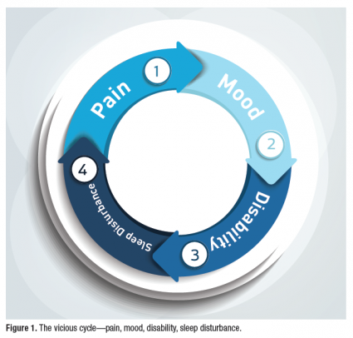
The effects of night pain
Night Pain is highly associated with poor sleep in Axial SpA¹
Poor sleep is associated with higher disease activity, lower mood and lower quality of life² . Which comes first?
Be aware of your mental and emotional health as well as treating the pain
Try to maintain good sleep hygiene
Be aware of falling into poor sleep routines
Li et al.. Arthritis Research Therapy. 2012 14:R215
Wadeley et al. Clinical Rheumatology. 2018. 37(4):1045-1052
Figure 1: www.practicalpainmanagement.com/pain/other/co-morbidities/sleep-wake-disorders-chronic-pain-reciprocal-interactive-effect

Slide 4
Explore pain relief:
Massage/ acupressure for muscle tightness
Hot/ cold packs
TENS therapy
Electric blanket (don’t leave it on overnight!)
Activity

Slide 5
Stay Active
Modify/ adapt where needed
Substitute weight-bearing for weight-assisted if needed
Get outdoors in the day time
Look at your amount of sedentary time.. especially in the evening
Be aware of over-resting if feeling tired.
Take an evening stroll

Slide 6
Prep your body for the night..
Massage and/or hot bath/shower to aid muscle relaxation
Gentle stretching/ movement to target areas that get stiff overnight:
6pm stretch
Bed exercises
Add in some structured relaxation
Breathing exercises/ mindfulness
https://nass.co.uk/managing-my-as/exercise/stretches-for-your-daily-life/

Slide 7
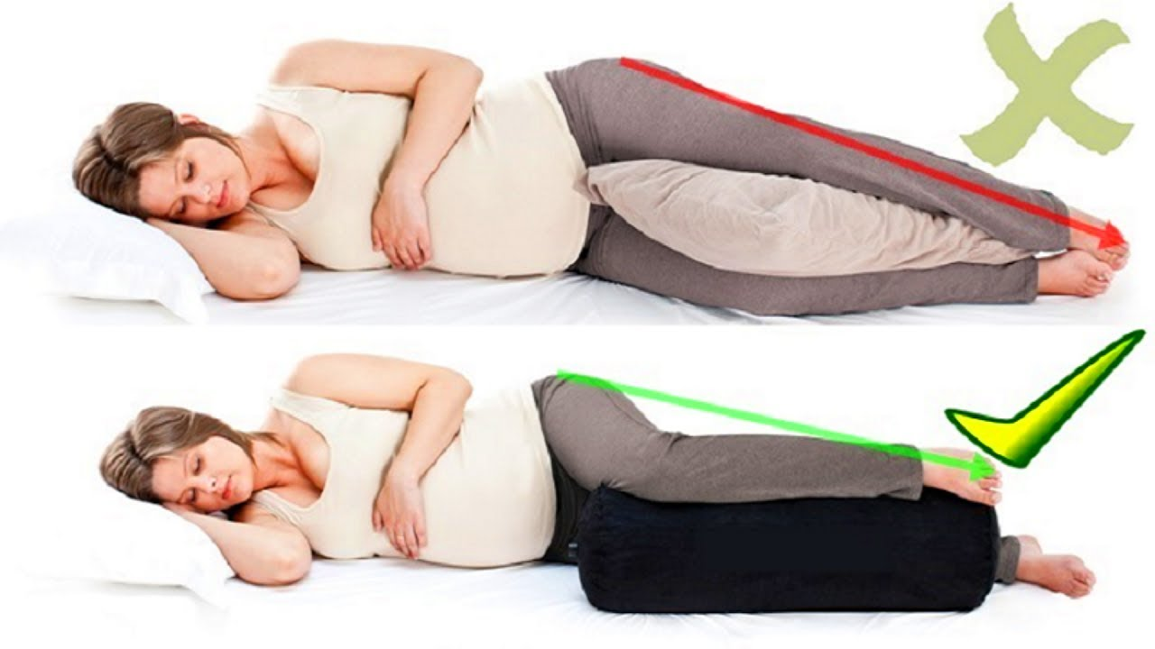
Getting comfortable
Neck discomfort:
Roll a small towel to bridge the gap between neck and bed
Pelvic/ lower back pain:
Pillow between knees AND ankles
Shoulder/ hip pain:
Quarter turn with pillow behind back or front to reduce pressure points
Experiment with mattress toppers

Slide 8
Seeking further help:
Your GP can help with short-term measures to help with a flare:
Review timing of medication for relief overnight
Short-term additional pain relief
Steroid injections for painful joints (e.g shoulder)
Your Rheumatology team can review more persistent problems:
Review of medications to control underlying inflammation
Any onset of night pain that is new and unfamiliar should be checked with your doctor.

Slide 9
Plan for the night ahead
How can I build in some relaxation time?
What do I need to move/ stretch before bed?
Have I been active enough today?
Is there anything on my mind?
Is my bedroom set up for sleep?
Do I need extra medication?

Slide 10
Further resources
Sleep Hygiene:
www.sleepfoundation.org
www. sleepcouncil.org.uk
www.sleepio.com
Sleep and Arthritis:
www.versusarthritis.org/news/2021/february/top-tips-for-good-sleep/
Exercises:
www.nass.co.uk/managing-my-as/exercise/stretches-for-your-daily-life

